Slide 1
Basic Spring 4.0
Lesson 3: Spring Java Base Configuration
Notes:
Add instructor notes here.

Slide 2
Lesson Objectives
Develop Spring Application Using Java Base Configuration
Java Configuration Class
@Configuration
@Bean
Implementing Bean Lifecycle Callbacks and Bean Scope
Registering Configuration Using AnnotationConfigApplicationContext
Notes:
Explain the lesson coverage

Slide 3
3.1 Develop Spring Application Using Java Base Configuration
Spring 3 onwards a spring application can be configured
with almost no XML using pure java.
Java base configuration allows moving bean definition and
spring configuration out of XML file into a java classes.
Notes:
While there are several other Java expression languages available, OGNL, MVEL, and JBoss EL, to name
a few, the Spring Expression Language was created to provide the Spring community with a single well
supported expression language that can be used across all the products in the Spring portfolio.

Slide 4
3.1 Example - MyBookConfig .java
@Configuration
public class MyBookConfig
{
@Bean
public Author author()
{
return new Author("Kanetkar","Nagpur");
}
@Configuration indicates that the class can be used by the Spring IoC container as a source of bean definitions.
Notes:
Annotating a class with the @Configuration indicates that the class can be used by the Spring IoC container as a source of bean definitions.

Slide 5
3.1 Example -MyBookConfig .java
@Bean annotation tells Spring that a method annotated with @Bean will return an object that should be registered as a bean in the Spring application context
@Bean(initMethod="setUp",destroyMethod="cleanUp")
//@Scope("prototype")
public Book book()
{
Book book=new Book();
book.setYear("1995");
book.setIsbn("Kj77756");
book.setAuthor(author());
return book;
}
}

Slide 6
3.2 Java Configuration Class
@Configuration - The java base equivalent to <beans> in xml
is a Java class annotated with @Configurations
@ Bean -This annotation is used to define the beans.

Slide 7
3.3:Implementing Bean Lifecycle Callbacks And Bean Scope
@PostConstruct - This Annotation is used on a method that
needs to be executed after dependency injection is done
to perform any initialization.
@PreDestroy - This Annotation is used on methods as a
callback notification to signal that the instance is in
the process of being removed by the container.
@Scope - This annotation is used in java base configuration
to define the scope of the bean
Note:-The @PostConstruct and @PreDestroy annotation are not
belong to Spring, it’s located in the J2ee library – common-
annotations.jar.

Slide 8
3.3 Example - Author .java
package com.cg.bean;
import javax.annotation.*;
public class Author{
private String authorName;
private String address;
public String getAuthorName() {return authorName;}
public void setAuthorName(String authorName) {
this.authorName = authorName; }
public String getAddress() {return address;}
public void setAddress(String address) {
this.address = address;
}

Slide 9
3.3 Example - Author .java
public Author(String authorName, String address)
{
super();
this.authorName = authorName;
this.address = address;
}
@Override
public String toString() {
return "Author [authorName=" + authorName + ", address=" + address+ "]";}
@PostConstruct
public void customAuthorInit()
{
System.out.println("Method customAuthorInit() invoked..."); }
@PreDestroy
public void customAuthorDestroy()
{ System.out.println("Method customAuthorDestroy() invoked..."); }}

Slide 10
3.3 Example - Book .java
package com.cg.bean;
public class Book
{
private Author author;
private String isbn;
private String year;
@PostConstruct
public void customBookInit()
{ System.out.println("Method
customBookInit() invoked...");
}
@PreDestroy
public void customBookDestroy()
{
System.out.println("Method
customBookDestroy() invoked...");
}

Slide 11
3.3 Example - Book .java
public void setUp()throws Exception
{
System.out.println(" Initializing the Book Bean with custom Config");
}
public void cleanUp()throws Exception
{
System.out.println(" Destroying the Book Bean with custom
Config");
}

Slide 12
3.3 Example - Book .java
public Author getAuthor() { return author; }
public void setAuthor(Author author) {this.author = author;}
public String getIsbn() { return isbn; }
public void setIsbn(String isbn) {this.isbn = isbn; }
public String getYear() {return year; }
public void setYear(String year) {this.year = year; }
@Override
public String toString()
{
return "Book [author=" + author + ", isbn=" + isbn + ", year=" + year + "]";
}}

Slide 13
3.4 Registering Configuration Using AnnotationConfigApplicationContext -BookClient.java
package com.cg.bean;
import org.springframework.context.ApplicationContext;
import org.springframework.context.annotation.AnnotationConfigApplicationContext;
public class BookClient {
public static void main(String[] args)
{
ApplicationContext ctx= new
AnnotationConfigApplicationContext(MyBookConfig.class);
Book book1=(Book)ctx.getBean("book");
System.out.println(" Book HashCode : "+book1.hashCode());
System.out.println(" Book Info : "+book1);
try
{
book1.cleanUp();
}
catch (Exception e) {
e.printStackTrace(); }}
Notes:
Bean in spring can be created in java file instead of XML,too. They are created with the help of @Configuration. And that application configuration is loaded
by AnnotationConfigApplicationContext in spring container.
ApplicationContext ctx= new AnnotationConfigApplicationContext(MyBookConfig.class);
Create a new AnnotationConfigApplicationContext, deriving bean definitions from the given annotated classes and automatically refreshing the context.
AnnotationConfigApplicationContext has the register method as well that accepts the bean configuration class.
AnnotationConfigApplicationContext provides the method getBean to get the bean object.

Slide 14
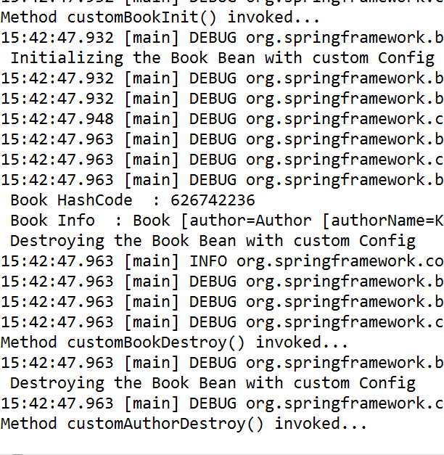
3.4 Registering Configuration Using AnnotationConfigApplicationContext -BookClient.java
output

Slide 15
3.4 Registering Configuration Using Boot - BookClient.java
//@Configuration
//@ComponentScan
//@EnableAutoConfiguration
@SpringBootApplication
public class BookClient
{
public static void main(String[] args)
{
ApplicationContext ctx= SpringApplication.run(BookClient.class,
args);
System.out.println("Welcome To Spring Boot Applications");
Book book1=(Book)ctx.getBean("book");
System.out.println(" Book HashCode : "+book1.hashCode());
System.out.println(" Book Info : "+book1);
try
{
book1.cleanUp(); }
catch (Exception e) {
e.printStackTrace(); }}
Notes:
@EnableAutoConfiguration annotation auto-configures the beans that are present in the classpath. This simplifies the developers work by guessing the required beans from the classpath and configure it to run the application. This annotation is part of the spring boot project.
With the spring boot 1.2.0 release, the need for this annotation has been reduced because there is an alternative annotation @SpringBootApplication which combines the three annotations @Configuration,@EnableAutoConfiguration and @ComponentScan.

Slide 16
Lesson Summary
We have so far seen:
Java base configuration in spring
Notes:
Additional notes for instructor

Slide 17
Review Questions
Question 1:Which annotation indicates that the
class can be used by the Spring IoC container as a
source of bean definitions
Option1:@Configuration
Option2:@Bean
Option3:@Component
Question 2: Once your configuration classes are
defined, you can load and provide them to Spring
container using _________.
Option 1: ConfigApplicationContext
Option 2: AnnotationApplicationContext
Option3: AnnotationConfigApplicationContext
Notes:
Ans-1 : Option 1
Ans-2 : Option 3

